Slide 3
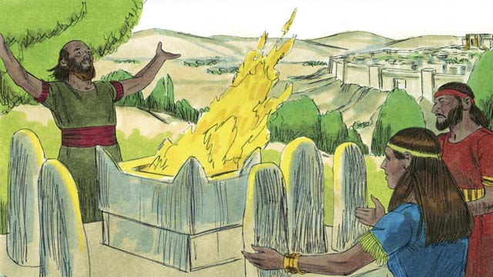
This Photo by Unknown Author is licensed under CC BY-SA

Slide 4
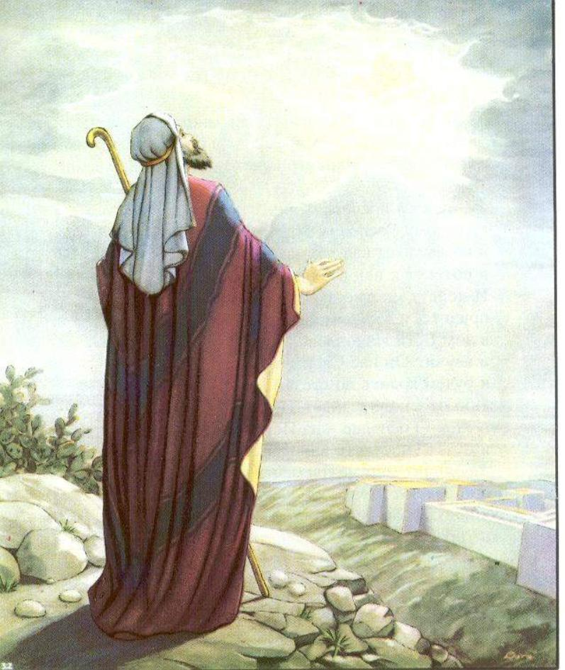
This Photo by Unknown Author is licensed under CC BY-NC-ND

Slide 5
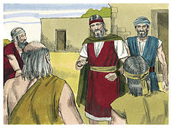
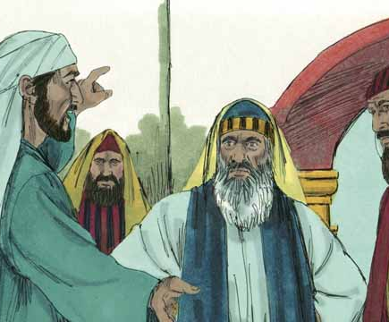
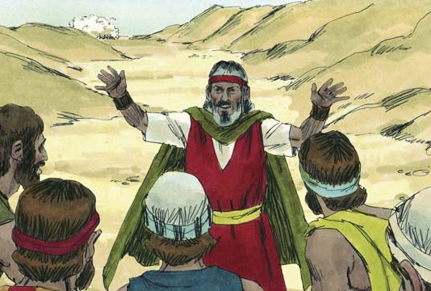
This Photo by Unknown Author is licensed under CC BY-SA
This Photo by Unknown Author is licensed under CC BY-SA
This Photo by Unknown Author is licensed under CC BY-SA

Slide 6
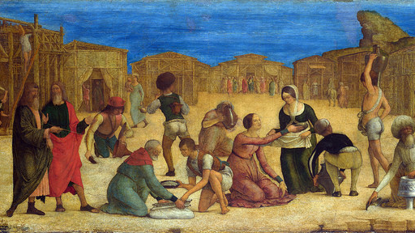
This Photo by Unknown Author is licensed under CC BY-SA-NC

